Slide 1
An Efficient Approach to Scaling the Panoramic X-ray Tooth Instance Segmentation Dataset
MICCAI STS 2024 Challenge
Notes:
"Good day, everyone. Today, I will be presenting our work on An Efficient Approach to Scaling the Panoramic X-ray Tooth Instance Segmentation Dataset. Our focus has been on addressing the challenges involved in tooth instance segmentation within panoramic X-rays, while also proposing solutions for scaling the dataset in a semi-supervised manner. This is part of the STS24 challenge for teeth segmentation."

Slide 2
Problems
Object Detection Problem
Semantic Segmentation Problem
Active Learning Problem
Instance Segmentation Problem
Notes:
Slide 2: Problems "Our approach was guided by several core problems that need to be addressed when working with this dataset. These include:
Object Detection Problem: Identifying and locating individual teeth within the panoramic X-ray images.
Semantic Segmentation Problem: Classifying each pixel in the image to label it as part of a tooth or background.
Active Learning Problem: Maximizing performance given the scarcity of labeled data.
Instance Segmentation Problem: Precisely segmenting each individual tooth, distinguishing between teeth even when they are adjacent or overlapping."

Slide 3
Baseline Model - Instance Segmentation
The baseline model solves the problem in an end-to-end manner, as per the emphasis on performance stressed by the organizers, we decided that we want a model which is fast and reliable.
Notes:
So let us discuss our baseline model, which is similar to the final model we present as our algorithm. We decided that we wanted an instance segmentation model that is tested, fast, and reliable. As the organizers have stressed, perfomance as well as accuracy are both important in this competition.

Slide 4
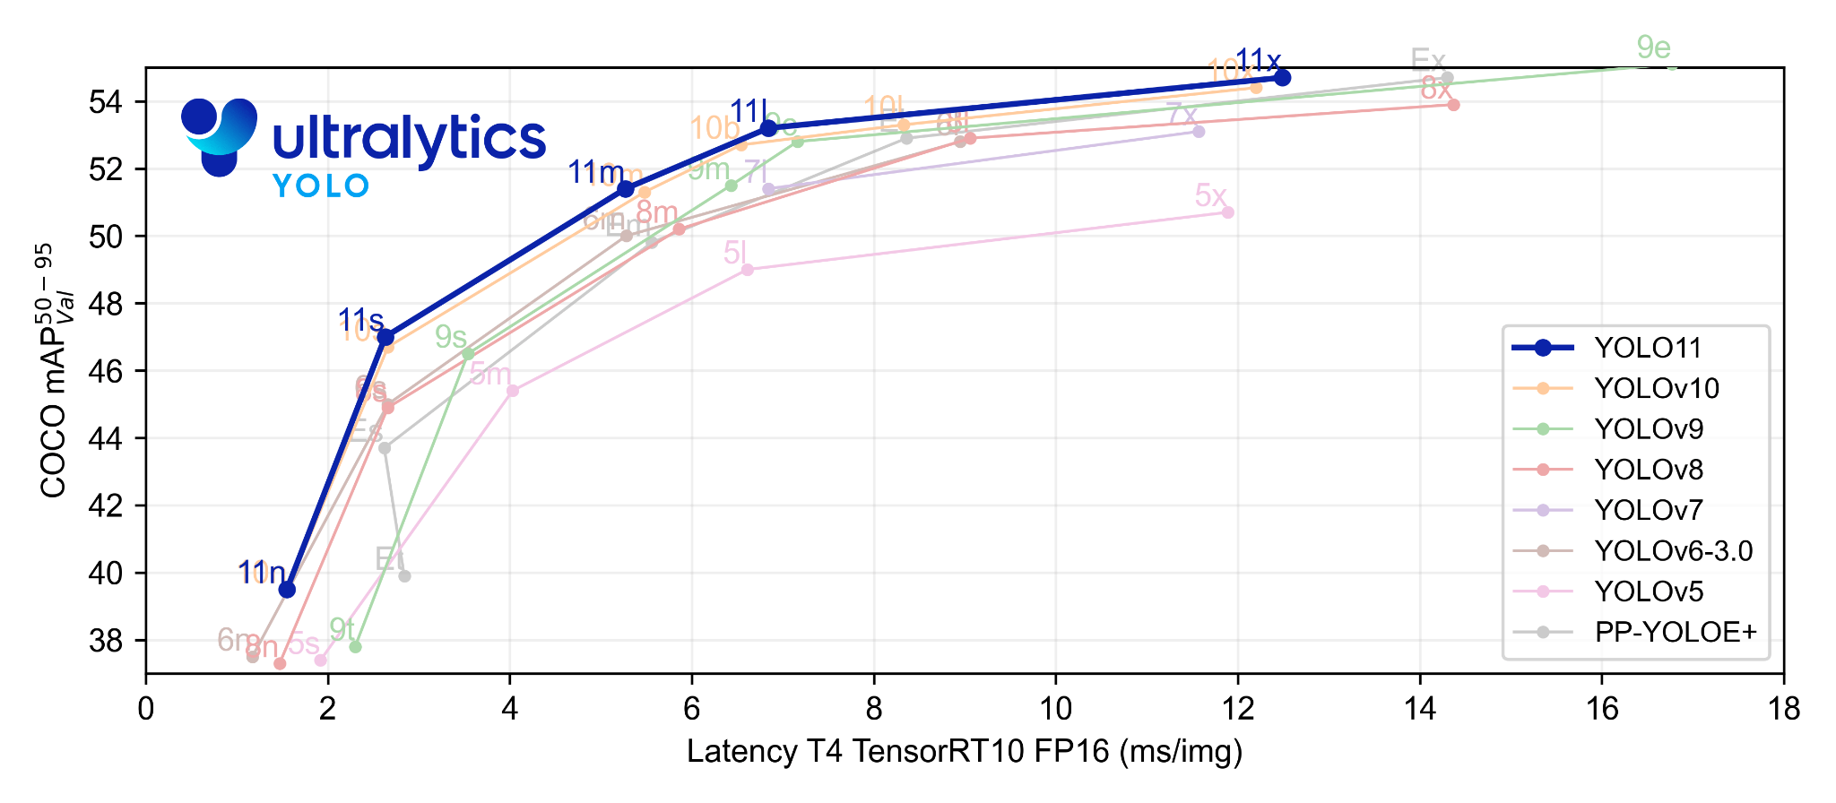
Ultralytics YOLO v8
Notes:
Naturally we turn to the YOLO series, which is quite popular in the industry, and has withstood years and years of testing and improvement. We use the ultralytics implementation as our baseline code. However, the baseline ultralytics implementation wasn't quite sufficient for our specific task, so modifications and improvements are needed to be made.

Slide 5
Segmentation Accuracy Problem
Several changes needed to be done for our specific task. The ultralytics implementation computes segmentation loss with a ⅛ downsampled feature map, this would not satisfy our requirement for accuracy.
Notes:
It computes segmentation loss using a 1/8 downsampled feature map, which would not provide the accuracy we require for our application.

Slide 6
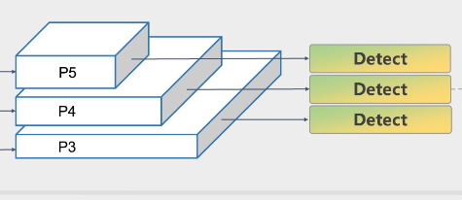
Feature Pyramid Network
Notes:
Ultralytics utilizes fpn, or feature pyramid network, this combines feature maps of differenct scale to achieve a balance in low and high resolution, we modify this portion of the baseline network to adapt it for our high resolution dataset.

Slide 7
Improved FPN Layer
We modified the ultralytics implementation with additional upsampling operations, which results in more accurate segmentations on the instances.

Slide 8
Bounding Box Detection Problems
When the bounding box detection fails, sometimes it crops out part of the tooth. We do not want that as we would need to train the model to correctly segment the whole tooth from its background, disregarding how much of background there is.
Notes:
"One issue we encountered was with the bounding box detection. Occasionally, the model would fail and crop out parts of a tooth. This could severely impact segmentation accuracy. Our solution was to adjust the model to correctly segment the entire tooth, even when it includes parts of the background. Essentially, we trained the model to ignore how much background is included and focus on ensuring that the full tooth is captured in the segmentation."

Slide 9
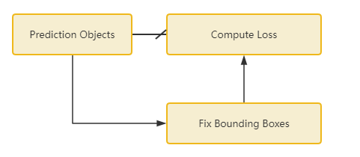
Bounding Box Detection Problems

Slide 10
Improved Loss
As described in the previous slides, we have modified the original loss function to fit better the task at hand.

Slide 11
STS 2024 Dataset
Training set: 2400 panoramic X-ray images, including 20 cases with labels and 2380 unlabeled cases
Validation set: 20 panoramic X-ray images
Testing set: Undisclosed to participants

Slide 12
Semi-Supervision Challenge
The dataset in question presents a semi-supervision challenge, as we have noted, there is a large repository of unlabelled data within the training set. Accommodations must be made for this fact.
Notes:
"Since our training set contains mostly unlabeled data, we have a semi-supervised learning problem on our hands. Although fully supervised training is always preferable, we simply don’t have enough labeled data. Therefore, we developed an automated method to assign labels to this large repository of unlabeled data, using the limited labeled data we already have."

Slide 13
Automated Data Procurement
Since it is always better to opt for fully supervised training if possible, we formulate this problem into an automated way to assign labels to a large unlabelled repository of data from limited data we have.

Slide 14
Segment Anything Model
To acquire segmentation, we harness the power of SAM.
Notes:
SAM (Segmentation Anything Model) is a versatile model designed to handle a wide range of image segmentation tasks. It can generate highly precise segmentations based on minimal input prompts, such as bounding boxes or key points. SAM is particularly powerful because it is capable of generalizing across different image domains without the need for task-specific training. In the context of our work, SAM is used to segment teeth accurately from panoramic X-rays by taking bounding boxes generated by our object detection model and refining them into precise tooth outlines.

Slide 15
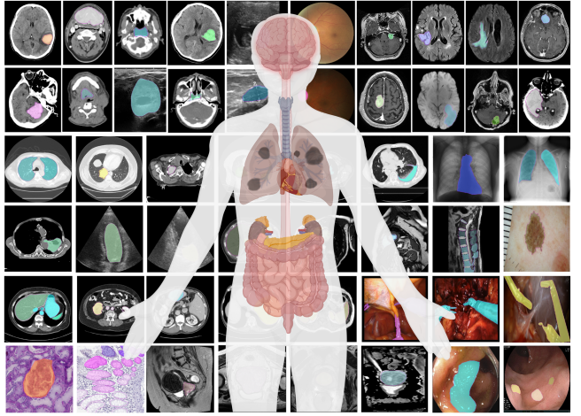
Segment Anything Model

Slide 16
Trivial Object Detection Problem
Given the limited training data, it is possible to produce a simple object detection model to produce bounding boxes that we will need as prompts to SAM. Of course the problem of tooth number assignment must be resolved.

Slide 17
Tooth Number Assignment Problem
Tooth number is a rather unique problem to this challenge, many a times hard to distinguish. Tooth number is a property that is unique to each instance, and often both spatial information and structural information play a part in its determination. This is difficult to resolve alone in a object detection problem.

Slide 18
Maximum Weight Matching
We instead formulate the problem based on the output of our model, disregarding the possibility of duplicate classes in the model itself. We then resolve conflicts based on the confidence score the model has on each of the predictions. Which we then solve with a trivial hungarian algorithm.

Slide 19
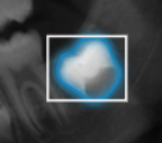
Task-Specific Finetune
Some segmentation details are task specific, for instance, SAM will always segment some unerupted teeth as a circular shape, but the provided GT labels will only cover part of the crown. We collect information such as this and finetune the model to offset the differences.

Slide 20
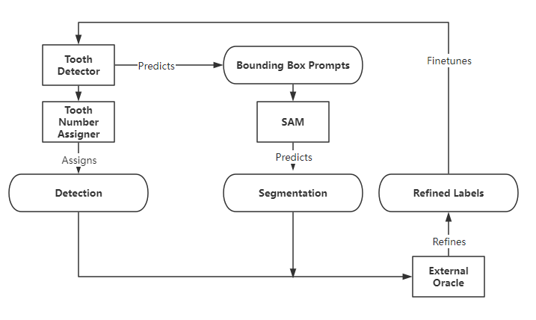
Iterative Optimization of Data

Slide 21
Fully Supervised Training
Finally, we produce the final model with fully supervised training when we collected all the labelled data.

Slide 22
References
Ma, J., He, Y., Li, F., Han, L., You, C., & Wang, B. (2024). Segment anything in Medical Images. Nature Communications, 15(1). https://doi.org/10.1038/s41467-024-44824-z
Jocher, G., Qiu, J., & Chaurasia, A. (2023). Ultralytics YOLO (Version 8.0.0) [Computer software]. https://github.com/ultralytics/ultralytics

